Slide 1
2019 Alabama
Economic Outlook
Ahmad Ijaz
Center for Business and Economic Research
Culverhouse College of Business
The University of Alabama

Slide 2
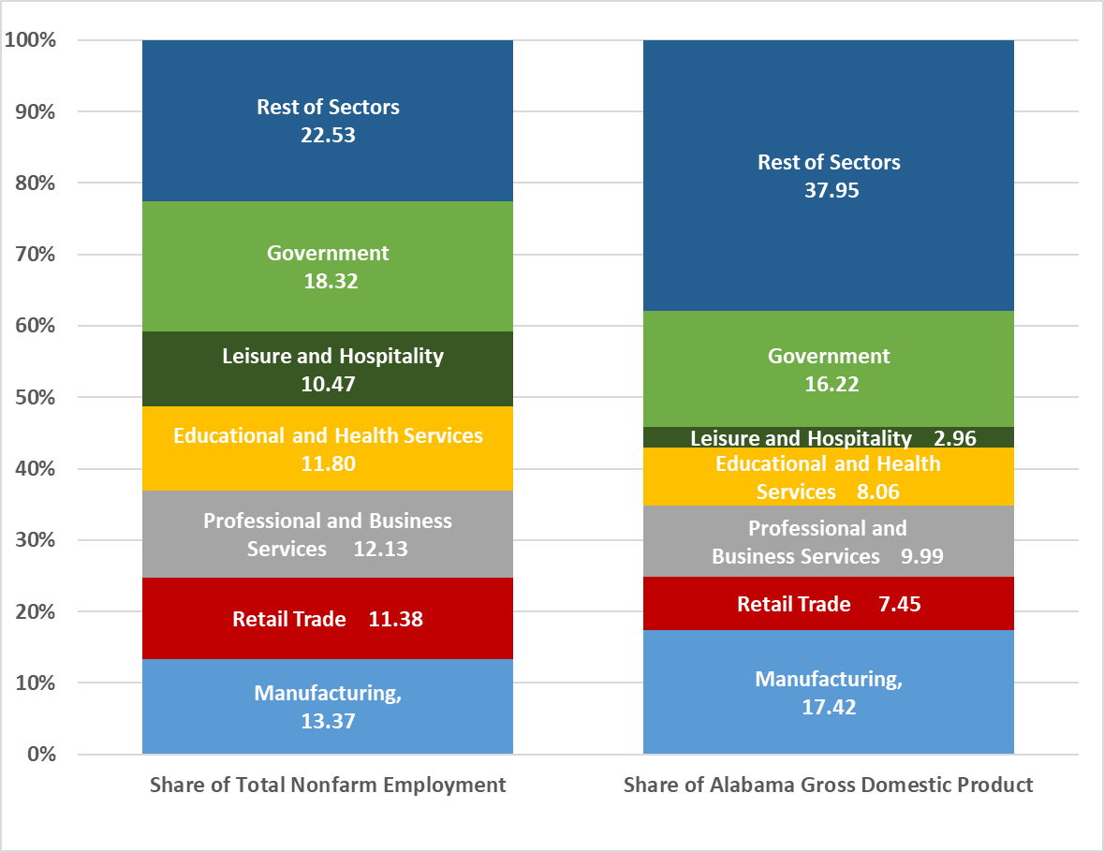
Shares of Total Alabama GDP (2017) and Share of Alabama Employment (2017)
Source: U.S. Bureau of Economic Analysis and Bureau of Labor Statistics

Slide 3
Alabama Nonagricultural Employment (Change in Number of Jobs)
 |  | Nov. 2016 to Nov. 2017 |  | Nov. 2017 to Nov. 2018
Total Nonagricultural |  | 30,500 |  | 35,400
Mining and Logging |  | -100 |  | 100
Construction |  | 6,600 |  | 1,200
Manufacturing |  | 5,600 |  | 10,200
Durable Goods Manufacturing |  | 3,100 |  | 6,500
Nondurable Goods Manufacturing |  | 2,500 |  | 3,700
Trade, Transportation and Utilities |  | -2,000 |  | 1,200
Wholesale Trade |  | 700 |  | -600
Retail Trade |  | -1,700 |  | -200
Transportation, Warehousing and Utilities |  | -1,000 |  | 2,000
Information |  | -500 |  | 200
Financial Activities |  | 500 |  | 1,800
Professional and Business Services |  | 4,500 |  | 11,900
Educational and Health Services |  | 4,800 |  | 3,200
Leisure and Hospitality |  | 5,200 |  | 2,200
Other Services |  | 2,300 |  | 1,200
Government |  | 3,600 |  | 2,200
Federal Government |  | -400 |  | 100
State Government |  | 2,700 |  | 700
Local Government |  | 1,300 |  | 1,400
Source: Alabama Department of Labor, Labor Market Information Division.

Slide 4
Monthly Employment Indicators (Nov. 2018)
 |  |  |  |  | Not Seasonally Adjusted |  | Seasonally Adjusted
Civilian Labor Force |  |  |  |  | 2,220,114 |  | 2,215,839
Percent Change from Year Ago Level |  |  |  |  | 2.7% |  | 2.4%
Absolute Change from Year Ago Level |  |  |  |  | 58,373 |  | 52,117
Employed |  |  |  |  | 2,144,653 |  | 2,128,082
Percent Change from Year Ago Level |  |  |  |  | 2.7% |  | 2.2%
Absolute Change from Year Ago Level |  |  |  |  | 57,369 |  | 46,330
Unemployed |  |  |  |  | 75,461 |  | 87,757
Percent Change from Year Ago Level |  |  |  |  | 1.3% |  | 7.1%
Absolute Change from Year Ago Level |  |  |  |  | 1,004 |  | 5,787
Alabama Unemployment Rate |  |  |  |  | 3.4% |  | 4.0%
Alabama Unemployment Rate (November 2017) |  |  |  |  | 3.4% |  | 3.8%
U.S. Unemployment Rate |  |  |  |  | 3.5% |  | 3.7%
U.S. Unemployment Rate (November 2017) |  |  |  |  | 3.9% |  | 4.1%
Source: Alabama Department of Labor, Labor Market Information Division.

Slide 5
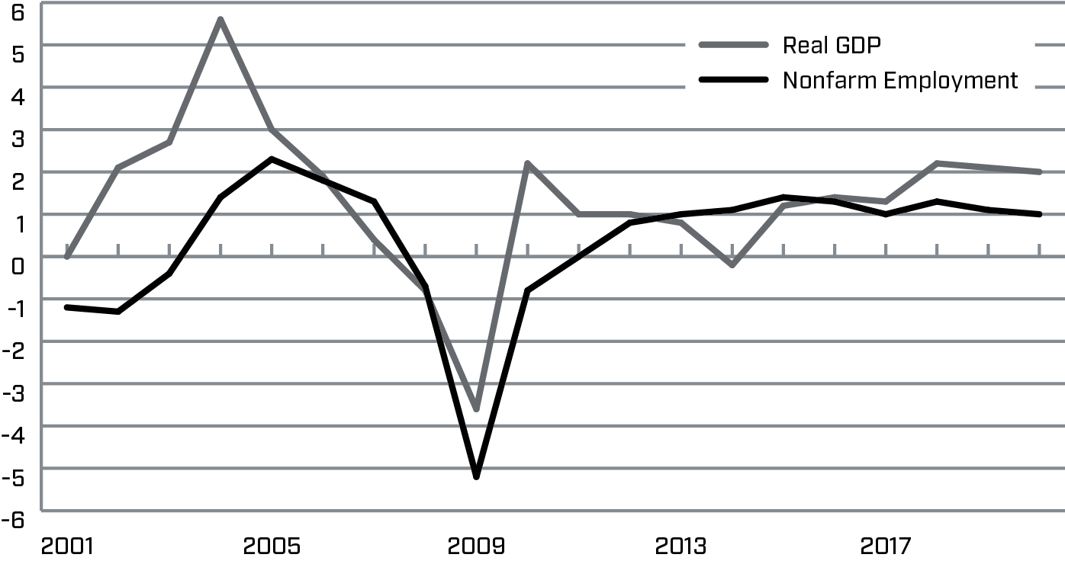
Alabama GDP and Nonfarm Employment
(Annual Percent Change)
Source: U.S. Bureau of Economic Analysis, U.S. Bureau of Labor Statistics and Center for Business and Economic Research, The University of Alabama.

Slide 6
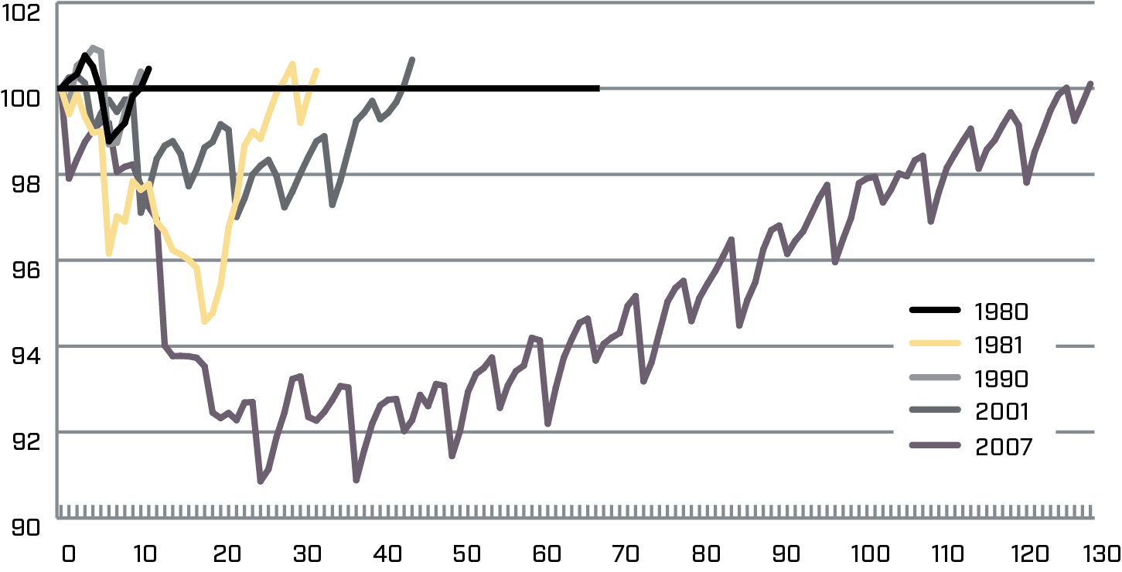
Change in Employment from the Beginning of the Recession (Number of Months)
Source: U.S. Department of Labor and Center for Business and Economic Research, The University of Alabama.

Slide 7
Labor Force Participation Rate
(Annual Percent Change)
Source: U.S. Department of Labor and the Center for Business and Economic Research, The University of Alabama.

Slide 8
Top 5 Export Industries of Alabama, 2017 (Billions of Dollars)
Transportation Equipment | $11.0
Chemicals | $2.3
Primary Metal Manufacturing | $2.0
Machinery; Except Electrical | $1.4
Paper | $1.0
Source: International Trade Administration, U.S. Department of Commerce.

Slide 9
Top 5 Destinations of Alabama Exports, 2017
(Billions of Dollars)
Canada | $4.2
China | $3.6
Germany | $3.0
Mexico | $3.0
Japan | $0.7
Source: International Trade Administration, U.S. Department of Commerce.

Slide 10
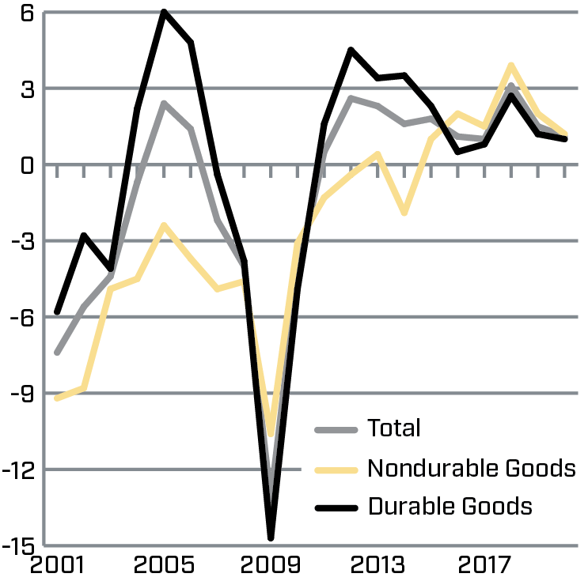
Alabama Manufacturing Employment
(Annual Percent Change)
Source: Alabama Department of Labor and Center for Business and Economic Research, The University of Alabama.

Slide 11
Aging Alabama Population - Projections
 | Census | Population Projections | 2010 - 2030
 | 2010 | 2030 | Number | Percent
Under 15 years | 932,841 | 909,885 | -22,956 | -2.5%
15 to 64 years | 3,189,103 | 3,146,709 | -42,394 | -1.3%
65 years and over | 657,792 | 1,067,786 | 409,994 | 62.3%
Total | 4,779,736 | 5,124,380 | 344,644 | 7.2%
Source: U.S. Census Bureau, Census 2010, and
Center for Business and Economic Research, The University of Alabama, November 2018.

Slide 12
Shares of Alabama GDP and Employment by Metro Area
Source: U.S. Bureau of Economic Analysis and Bureau of Labor Statistics

Slide 13
Metro Share of State GDP, 2017
Source: U.S. Bureau of Economic Analysis, Center for Business and Economic Research,
The University of Alabama.

Slide 14
Real Gross Domestic Product
All Industry Total (Millions of Chained 2012 Dollars)
 |  |  | Percent Change
 |  |  | 2008 to | 2016 to
 | 2017 | Rank | 2017 | 2017
Alabama | 182,843 | -- | 4.3% | 0.7%
Anniston-Oxford-Jacksonville | 3,419 | 11 | -13.9% | 1.2%
Auburn-Opelika | 4,715 | 7 | 22.1% | 3.9%
Birmingham-Hoover | 55,927 | 1 | 4.2% | 1.4%
Daphne-Fairhope-Foley | 6,302 | 6 | 11.2% | 2.4%
Decatur | 4,654 | 8 | -6.7% | -0.2%
Dothan | 4,635 | 9 | 0.6% | 1.5%
Florence-Muscle Shoals | 4,346 | 10 | 7.8% | 0.6%
Gadsden | 2,606 | 12 | -0.6% | 1.0%
Huntsville | 22,678 | 2 | 13.0% | 1.9%
Mobile | 16,803 | 3 | 0.7% | -0.2%
Montgomery | 15,179 | 4 | -1.7% | -0.7%
Tuscaloosa | 10,198 | 5 | 14.4% | 5.3%
Source: U.S. Bureau of Economic Analysis.

Slide 15
Metro Exports, 2017
 | Total Merchandise | Percent Change
Metro Area | Exports, 2017 | 2016-2017
Alabama | $21.8 billion | 6.4
Anniston-Oxford-Jacksonville | $278.7 million | 0.0
Auburn-Opelika | $271.2 million | -32.5
Birmingham-Hoover | $2.1 billion | 12.3
Daphne-Fairhope-Foley | $1.8 billion | 32.0
Decatur | $448.6 million | -22.0
Dothan | $223.4 million | 0.6
Florence-Muscle Shoals | $271.5 million | -4.0
Gadsden | $30.3 million | -36.0
Huntsville | $1.9 billion | 3.4
Mobile | $1.8 billion | -7.5
Montgomery | $1.1 billion | -2.0
Tuscaloosa | NA | NA
Source: U.S. Department of Commerce, International Trade Administration.

Slide 16
Total Exports, Top Five Metro Areas, 2017 (Millions of Dollars)
Source: U.S. Department of Commerce, International Trade Administration.

Slide 17
Metro Share of State Exports (Percent)
 | 2017 | 2016
Alabama | 100.0 | 100.0
Anniston-Oxford-Jacksonville | 1.3 | 1.4
Auburn-Opelika | 1.2 | 2.0
Birmingham-Hoover | 9.6 | 9.1
Daphne-Fairhope-Foley | 8.1 | 6.6
Decatur | 2.1 | 2.8
Dothan | 1.0 | 1.1
Florence-Muscle Shoals | 1.2 | 1.4
Gadsden | 0.1 | 0.2
Huntsville | 8.7 | 8.9
Mobile | 8.4 | 9.7
Montgomery | 5.0 | 5.5
Tuscaloosa | NA | NA
Source: U.S. Department of Commerce, International Trade Administration.

Slide 18
Population gains varied widely since 2010
 |  | 7/1/2010 - 7/1/2017
 | 7/1/2017 | Number Change | Percent Change
Alabama | 4,874,747 | 89,168 | 1.9
Anniston-Oxford-Jacksonville | 114,728 | -3,738 | -3.2
Auburn-Opelika | 161,604 | 20,798 | 14.8
Birmingham-Hoover | 1,149,807 | 21,016 | 1.9
Daphne-Fairhope-Foley | 212,628 | 29,518 | 16.1
Decatur | 151,867 | -2,082 | -1.4
Dothan | 147,914 | 2,044 | 1.4
Florence-Muscle Shoals | 147,038 | -222 | -0.2
Gadsden | 102,755 | -1,702 | -1.6
Huntsville | 455,448 | 36,169 | 8.6
Mobile | 413,955 | 635 | 0.2
Montgomery | 373,903 | -1,225 | -0.3
Tuscaloosa | 242,799 | 12,312 | 5.3
Source: U.S. Census Bureau, Population Division.

Slide 19
Age Distribution of Alabama’ Workforce, 2017
Note: Daphne-Fairhope-Foley data unavailable. October 2018 preliminary not seasonally adjusted data.
Source: Alabama Department of Labor.

Slide 20
Top 5 Alabama Industries with Younger Workers,
Share of Workers Ages 14-34, 2017
Source: U.S. Census Bureau, QWI, and Center for Business and Economic Research, The University of Alabama.

Slide 21
Top 5 Alabama Industries with Older Workers,
Share of Workers Ages 55+, 2017
Source: U.S. Census Bureau, QWI, and Center for Business and Economic Research, The University of Alabama.

Slide 22
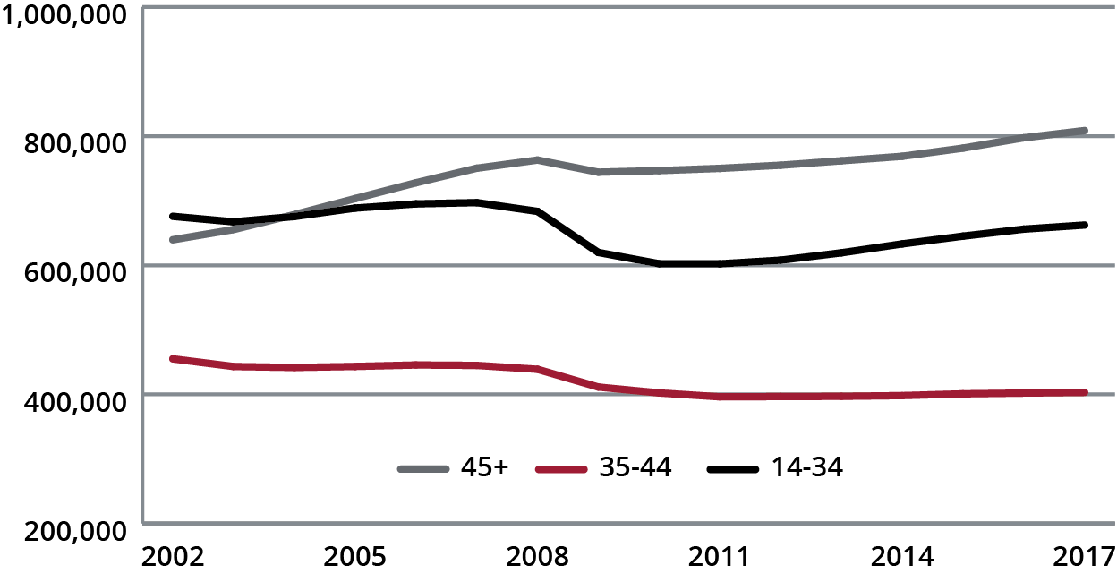
Alabama Workforce by Age Group
Source: U.S. Census Bureau, QWI, and Center for Business and Economic Research, The University of Alabama.

Slide 23
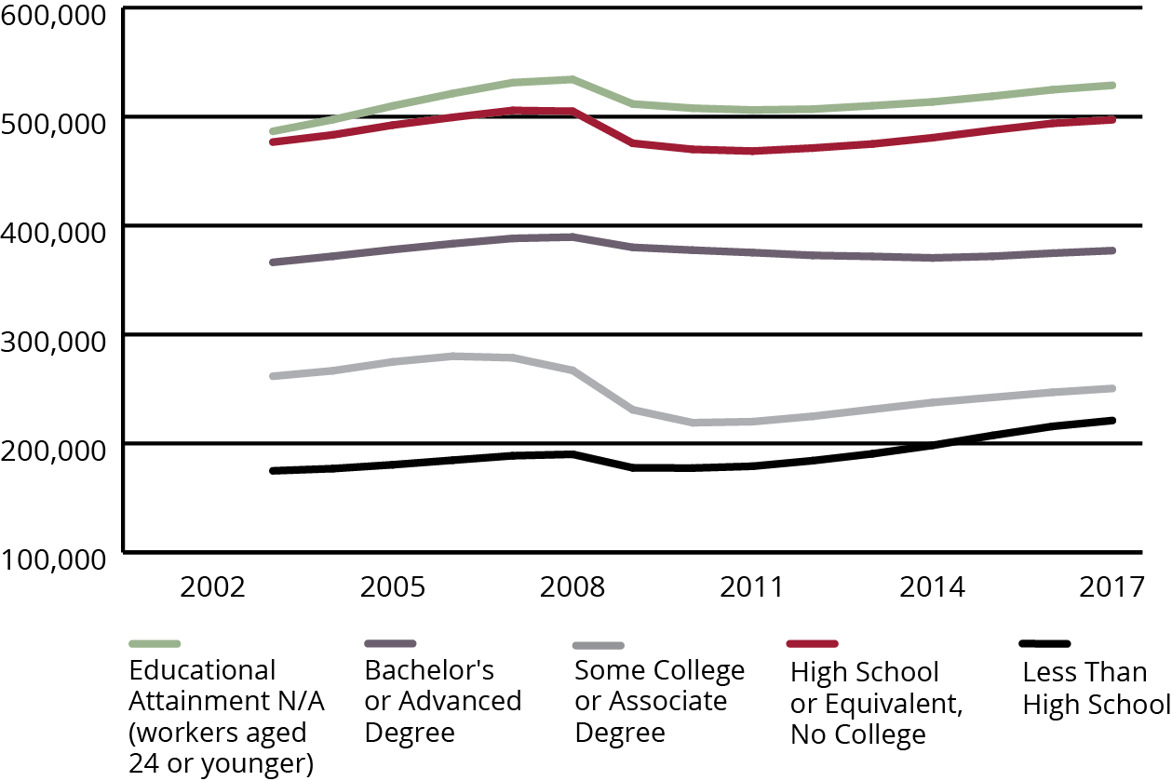
Alabama Workers by Educational Attainment
Source: U.S. Census Bureau, QWI.

Slide 24
GDP and Nonfarm Employment
Forecast 2019
 | Nonfarm Empl. Forecast, Percent | Real GDP Forecast, Percent | Rank, Empl. Forecast | Rank, GDP Forecast
Anniston-Oxford | 0.9 | 1.1 | 8 | 8
Auburn-Opelika | 1.2 | 3.0 | 4 | 1
Birmingham-Hoover | 1.0 | 1.2 | 7 | 5
Daphne-Fairhope-Foley, AL | 3.0 | 2.2 | 2 | 3
Decatur | 1.1 | 0.2 | 6 | 12
Dothan | 0.1 | 1.2 | 12 | 5
Florence-Muscle Shoals | 1.2 | 0.5 | 4 | 10
Gadsden | 0.5 | 0.8 | 10 | 9
Huntsville | 3.5 | 1.8 | 1 | 4
Mobile | 0.8 | 0.4 | 9 | 11
Montgomery | 0.5 | 1.2 | 10 | 5
Tuscaloosa | 1.4 | 2.4 | 3 | 2
Source: U.S. Department of Commerce, Alabama Department of Labor, and Center for Business and Economic Research, The University of Alabama.

Slide 25
Alabama Revenue Forecast
(Millions of Current Dollars)
 |  |  |  | FY2016 | FY2017 | FY2018 | FY2019 | FY2020
Total Tax Revenues |  |  |  | $ 9,897.3 | $ 10,309.2 | $ 10,979.0 | $ 11,451.1 | $ 11,874.7
Percent Change |  |  |  | 1.2 | 4.2 | 6.5 | 4.3 | 3.7
Sales Tax Revenues |  |  |  | $ 2,236.7 | $2,276.6 | $2,378.3 | $2,465.9 | $2,538.9
Percent Change |  |  |  | 3.9 | 1.8 | 4.5 | 3.7 | 3.0
Individual Income Tax Revenues |  |  |  | $ 4,072.0 | $ 4,206.8 | $ 4,567.1 | $ 4,795.3 | $ 4,986.8
Percent Change |  |  |  | 3.6 | 3.3 | 8.6 | 5.0 | 4.0
Corporate Income Tax Revenues |  |  |  | $ 417.0 | $ 459.9 | $ 504.9 | $ 515.1 | $ 524.4
Percent Change |  |  |  | (26.5) | 10.3 | 9.8 | 2.0 | 1.8
All Other Tax Revenues |  |  |  | $ 3,171.6 | $ 3,365.9 | $ 3,528.7 | $ 3,674.8 | $ 3,824.6
Percent Change |  |  |  | 1.4 | 6.1 | 4.8 | 4.1 | 4.1
Alabama Education Trust Fund |  |  |  | $ 6,072.9 | $ 6,326.9 | $ 6,753.3 | $ 6,989.4 | $ 7,158.7
Percent Change |  |  |  | 0.4 | 4.2 | 6.7 | 3.5 | 2.4
Alabama General Fund |  |  |  | $ 1,787.4 | $ 1,875.7 | $ 1,950.7 | $ 1,979.3 | $ 1,998.8
Percent Change |  |  |  | -0.7 | 4.9 | 4.0 | 1.5 | 1.0
Source: Alabama Department of Revenue and Center for Business and Economic Research, The University of Alabama. December 2018

Slide 26
Alabama Population and Projections by Age Group
Source: U.S. Census Bureau and Center for Business and Economic Research, The University of Alabama, November 2018.

Slide 27
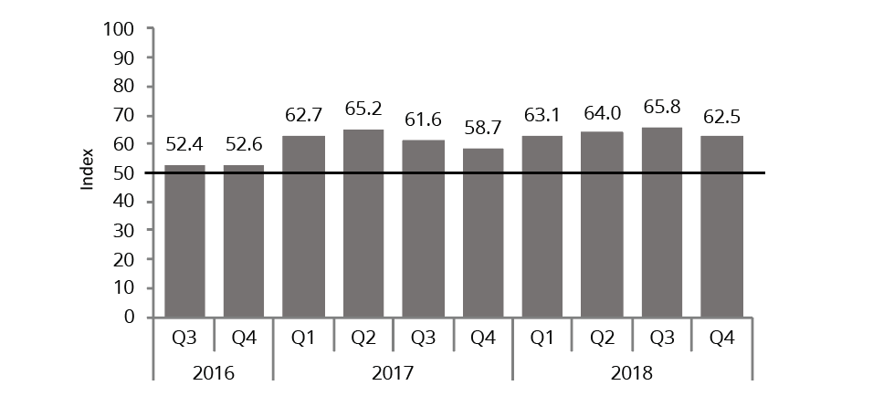
ABCI
(Expectations from Previous Quarters)
Source: Center for Business and Economic Research, The University of Alabama.

Slide 28

Alabama Forecast Summary
This Alabama GDP and employment forecast summary is the CBER December 2018 forecast
Preliminary 2020 forecast also included below
Probability: Forecast (60 Percent) and Range (90 percent)
(Percent change) | 2017 | 2018 | 2019 | 2020
Real GDP | 2.4 | 2.5 | 2.1 | 2.0
range |  |  | 1.5 to 2.5 | 1.0 to 3.0
Employment | 1.0 | 1.3 | 1.1 | 1.0
range |  |  | 0.7 to 1.3 | 0.6 to 1.5
Total Tax Receipts, FY | 4.2 | 6.5 | 4.3 | 3.7
range |  |  | 3.5 to 5.0 | 2.0 to 5.0

Slide 29
Thank you!
aijaz@cba.ua.edu
Center for Business and Economic Research
Culverhouse College of Business
The University of Alabama
http://cber.cba.ua.edu
205-348-6191

