Slide 1
Arriving at Normal
2019 Alabama Economic Outlook Conference
Montgomery, AL
January 10, 2019
The views expressed in this presentation do not represent those of the Federal Reserve Bank of Atlanta, the Federal Reserve System, or anyone other than the presenter. If you think you heard otherwise, you are mistaken.

Slide 2
The FOMC Summary of Economic Projections (SEP), December 2018.
2.3
Note: The red line is the median projection.
Sources: FOMC Summary of Economic Projections, December 2018; Bureau of Economic Analysis; Haver Analytics

Slide 3
The December SEP indicate sub-4 percent unemployment rates well into the future.
3.8
3.5
3.6
Note: The red line is the median projection.
Sources: FOMC Summary of Economic Projections, December 2018; Bureau of Labor Statistics; Haver Analytics

Slide 4
Extended periods with below 4% unemployment rates are historically rare.
data through December 2018
Source: Bureau of Labor Statistics; Haver Analytics

Slide 5
Bucking demographic trends, labor force participation has been essentially flat for the better part of three years.
Sources: Bureau of Labor Statistics; Haver Analytics
data through December 2018

Slide 6
Most notable: Prime-age labor force participation continues its rise.
Overall LFPR
Prime-age LFPR
Sources: Bureau of Labor Statistics; Haver Analytics
data through December 2018

Slide 7
Wage growth is coming to life, though still lower than the peaks levels of the last two expansions…
Average Hourly Earnings
Grey shaded regions represent NBER recession dates
* Unweighted series
Sources: Bureau of Labor Statistics, staff calculations; Haver Analytics
Earnings data through December 2018, Wage Tracker data through November 2018

Slide 8
… and inflation? Pretty much on target.
Headline PCEI
FOMC Longer-run target
PCEI ex Food and Energy
Sources: Bureau of Economic Analysis; Haver Analytics
data through November 2018

Slide 9
Equity markets, of course, are not so optimistic.

Slide 10
Growth in China is “fading.”
Source: IMF: World Economic Outlook Report October 2018

Slide 11
Policy uncertainty, of all sorts, is spiking.

Slide 12
Monetary policy – gone to neutral? Or beyond?
Sources: Federal Reserve Board; Haver Analytics; staff calculations
data through January 8, 2019

Slide 13
From the minutes of the December FOMC meeting
With an increase in the target range at this meeting, the federal funds rate would be at or close to the lower end of the range of estimates of the longer-run neutral interest rate…
many participants expressed the view that, especially in an environment of muted inflation pressures, the Committee could afford to be patient about further policy firming.
Source: https://www.federalreserve.gov/monetarypolicy/fomcminutes20181219.htm

Slide 14
Fed has a ‘tin ear’ to market concern over balance sheet
Published: Dec 20, 2018 4:14 p.m. ET

Slide 15
“[Powell] has the wrong approach; he thinks balance sheet reduction on autopilot is something separate from monetary policy; it is a form of tightening”*
* From appearance on CNBC’s Closing Bell program, December 27, 2018, as reported in Macro Viewpoints on December 30, 2018: http://cinemarasik.com/2018/12/interesting-tacs-of-the-week-december-22-december-28-2018/

Slide 16
Here’s what balance sheet policy looks like.
Balance sheet normalization process begins
Source: Federal Reserve Board; Haver Analytics
data through December 2018

Slide 17
Balance sheet policy logic -- the word from the (my) boss.
“The balance sheet normalization strategy was formulated under two guiding principles.
Source: “’Considerations on the Path from Extraordinary to Neutral,” November 15, 2018.
https://www.frbatlanta.org/news/speeches/2018/11/15-bostic-considerations-on-the-path-from-extraordinary-to-neutral

Slide 18
Balance sheet policy logic -- the word from the (my) boss.
“The balance sheet normalization strategy was formulated under two guiding principles.
The first was to implement the wind-down in a manner that would not disrupt financial markets
Source: “’Considerations on the Path from Extraordinary to Neutral,” November 15, 2018.
https://www.frbatlanta.org/news/speeches/2018/11/15-bostic-considerations-on-the-path-from-extraordinary-to-neutral

Slide 19
Balance sheet policy logic -- the word from the (my) boss.
“The balance sheet normalization strategy was formulated under two guiding principles.
The first was to implement the wind-down in a manner that would not disrupt financial markets
The second was to… [focus] ongoing policy adjustments via the traditional interest rate channel.”
Source: “’Considerations on the Path from Extraordinary to Neutral,” November 15, 2018.
https://www.frbatlanta.org/news/speeches/2018/11/15-bostic-considerations-on-the-path-from-extraordinary-to-neutral

Slide 20
Balance sheet policy logic -- the word from the (my) boss.
“For these reasons, the Committee chose a process that was phased in, gradual, and based on a relatively fixed schedule….”
Source: “’Considerations on the Path from Extraordinary to Neutral,” November 15, 2018.
https://www.frbatlanta.org/news/speeches/2018/11/15-bostic-considerations-on-the-path-from-extraordinary-to-neutral

Slide 21
Balance sheet shrinking: Treasuries
Source: Federal Reserve Bank of New York: https://www.newyorkfed.org/medialibrary/media/markets/omo/omo2017-pdf.pdf

Slide 22
Balance sheet shrinking: Mortgage-backed securities
Source: Federal Reserve Bank of New York: https://www.newyorkfed.org/medialibrary/media/markets/omo/omo2017-pdf.pdf

Slide 23
“I think the Fed's doing it wrong… I think that they should be selling their Treasurys.”
Jim Cramer on Mad Money, July 30, 2018
Source: https://www.cnbc.com/2018/07/30/cramer-on-feds-quantitative-easing-i-think-theyre-doing-it-wrong.html

Slide 24
The authoritative word.
“… we will be prepared to adjust policy quickly and flexibly and to use all of our tools to support the economy should that be appropriate to keep the expansion on track.”
Source: Federal Open Market Committee Chairman Jerome Powell, comments at the American Economic Association annual meeting, January 4, 2019

Slide 25
Q: What would it mean to be “on track”?
A: Sub-2% growth.
2.3
2.0
1.8
Note: The red line is the median projection.
Sources: FOMC Summary of Economic Projections, December 2018; Bureau of Economic Analysis; Haver Analytics

Slide 26
The basic arithmetic of growth.
Growth in labor hours
+
Growth in labor productivity
equals
Growth in GDP

Slide 27
According to the Congressional Budget Office: A slowdown in both productivity and labor growth.
Source: https://www.cbo.gov/publication/54189 , Congressional Budget Office, July 17, 2018.

Slide 28
As of now, 1.4% productivity growth looks aspirational.
1947-1972 1973-1995 1996-2003 2004-2007 2008-2010 2011-2018q3
**Note: Annualized growth rates are computed from Q4 of year prior to first year of range to Q4 of last year of range.
Sources: Bureau of Labor Statistics; Haver Analytics

Slide 29
3-D Metal Printing
Zero Knowledge Proof cryptography
(zk-Snark: Zcash)
Artificial Embryos
(University of Cambridge)
Zero-carbon Natural Gas
(Net Power, Houston TX)
Sensing City (Quayside, Toronto)
Generative Adversarial Network
Source: 10 Breakthrough Technologies 2018, MIT Technology Review

Slide 30
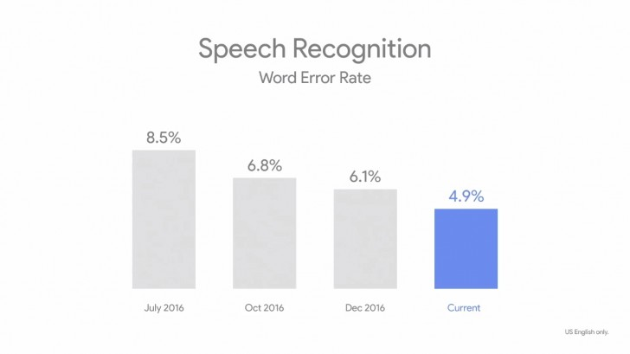
Google Home Speech Recognition
Sources: Chad Syverson, https://www.frbatlanta.org/-/media/documents/news/conferences/2018/0506-financial-markets-conference/presentations/syverson.pdf

Slide 31
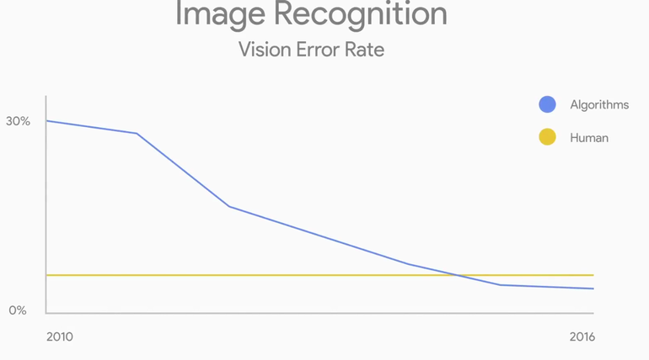
ML Has Crossed an Important Threshold
Sources: Chad Syverson, https://www.frbatlanta.org/-/media/documents/news/conferences/2018/0506-financial-markets-conference/presentations/syverson.pdf

Slide 32
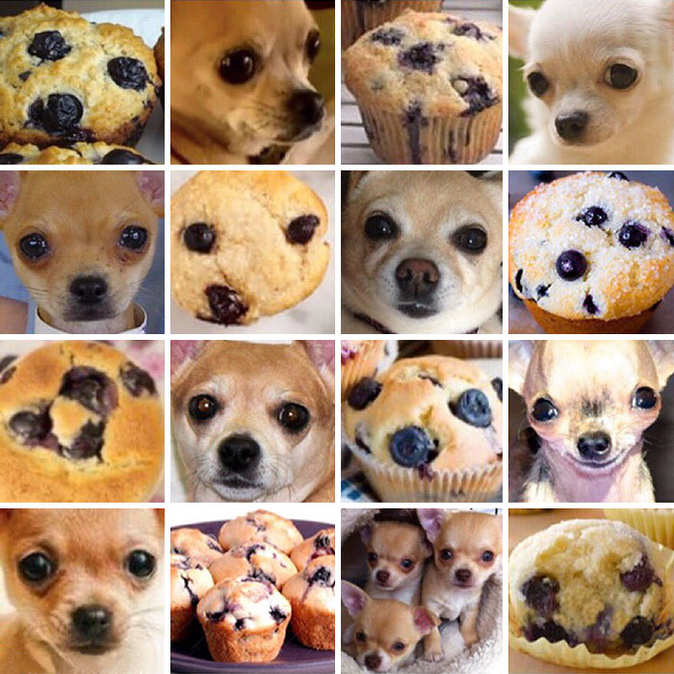
ML Has Crossed an Important Threshold
Sources: Chad Syverson, https://www.frbatlanta.org/-/media/documents/news/conferences/2018/0506-financial-markets-conference/presentations/syverson.pdf

Slide 33
AI Fail Example # 1: Alexa doesn’t know her audience.
Kid: “Alexa, play Digger, Digger.”
Source: https://www.entrepreneur.com/slideshow/289621

Slide 34
AI Fail Example #1: Alexa doesn’t know her audience.
Kid: “Alexa, play Digger, Digger.”
Alexa: “You want to hear a station for porn detected.
Source: https://www.entrepreneur.com/slideshow/289621

Slide 35
AI Fail Example #2: Google makes a mountain out of a man.
Source: https://medium.com/syncedreview/2018-in-review-10-ai-failures-c18faadf5983

Slide 36
AI Fail Example #3: Amazon recruiting tool is sexist.
Amazon scraps secret AI recruiting tool that showed bias against women.
Reuters
October 9, 2018
Source: https://uk.reuters.com/article/us-amazon-com-jobs-automation-insight/amazon-scraps-secret-ai-recruiting-tool-that-showed-bias-against-women-idUKKCN1MK08G,

Slide 37
Isn’t the pace of technology diffusion speeding up?
Are Smart Phones Spreading Faster than Any Technology in Human History?
MIT Technology Review
May 9, 2012
Source: Florida 2030: Florida Chamber Foundation, June 2018.

Slide 38
The history of the smart phone.
IBM Simon, 1993
Nokia 9000 Communicator, 1997
Sharp J-SH04, 2000
I-Phone, 2007

Slide 39
Is this time different? We’ve seen speeds of adoption comparable to smartphones in the past.
Year | Vacuum cleaners per dwelling | Mechanical Refrigerators per dwelling
1914 | 0 | 0
1919 | 0.09 | 0.005
1924 | 0.16 | 0.02
1929 | 0.30 | 0.08
1939 | NA | 0.44
1954 | 0.54 | 0.85
Source: Paul David, “The Modern Productivity Paradox in a Not-So-Distant Mirror”,

Slide 40
Can we reconcile rapid innovation and poor productivity growth?
“… it takes a considerable time—often more than is commonly appreciated—to be able to sufficiently harness new technologies.”
Source: Erik Brynjolfsson, Daniel Rock, and Chad Syverson; Artificial Intelligence and the Modern Productivity Paradox: A Clash of Expectations and Statistics,” NBER Working Paper 24001, November 2017.

Slide 41
“…slow productivity growth today does not rule out faster productivity growth in the future.”
Source: Jeremy Greenwood (http://www.jeremygreenwood.net/papers/3rdIR.pdf).

Slide 42
“…slow productivity growth today does not rule out faster productivity growth in the future.”
Source: Jeremy Greenwood (http://www.jeremygreenwood.net/papers/3rdIR.pdf).

Slide 43
General purpose technologies (GPTs): The innovations that drive innovation.
“… the more profound and far-reaching the potential restructuring, the longer the time lag between the initial invention of the technology and its full impact on the economy and society.”
Source: Erik Brynjolfsson, Daniel Rock, and Chad Syverson; Artificial Intelligence and the Modern Productivity Paradox: A Clash of Expectations and Statistics,” NBER Working Paper 24001, November 2017.

Slide 44
The Edison Nexus: GPT to Consumer Goods to Productivity
The housewife of the future… will be rather a domestic engineer than a domestic labourer, with the greatest of all hand maidens, electricity, at her service. This and other mechanical forces will so revolutionize the woman’s world that a large portion of the aggregate of woman’s energy will be conserved for use in broader, more constructive fields.
Thomas Edison,
Good Housekeeping Magazine interview
October 1912
Source: Greenwood and Sedshari http://www.jeremygreenwood.net/papers/etransf.pdf

Slide 45
“… seemingly unrelated innovations”
* Actual dates are 1924 to 1954.
Sources: Bureau of Labor Statistics, United States Census Bureau, David (1991); Haver Analytics

Slide 46
“… seemingly unrelated innovations”
Approval of the first oral contraceptive
* Actual dates are 1924 to 1954.
Sources: Bureau of Labor Statistics, United States Census Bureau, David (1991); Haver Analytics

Slide 47
“… seemingly unrelated innovations”
Approval of the first oral contraceptive
Penetration of vacuum cleaners rises from 16% to 54%*
Penetration of mechanical refrigerators rises from 2% to 85%*
* Actual dates are 1924 to 1954.
Sources: Bureau of Labor Statistics, United States Census Bureau, David (1991); Haver Analytics

Slide 48
AT&T Mobile Telephone System, 1946
Ericsson Mobile Telephone System A, 1956
Motorola DynaTAC portable phone, 1973
Motorola Microtac 9800X, 1989
…
Smart phones: The mash-up of communications and computing GPTs.
Manchester “Baby” 1948
Radio Shack TRS-80 Pocket Computer, 1980
Psion Organizer, 1984
IBM Simon, 1993
Nokia 9000 Communicator, 1997
Sharp J-SH04, 2000
I-Phone, 2007

Slide 49
Joseph Fry’s solid chocolate bars,
1847
Henry Nestle and Daniel Peter create milk chocolate,
1875
Rudolphe Lindt creates the milk chocolate bar,
1879
Reese’s Peanut Butter Cups
1928
Marcellus Gilmore Edson patents peanut paste,
1884
Dr. John H. Kellogg patents peanut process for making peanut butter,
1898
Peanut butter introduced at St. Louis World’s Fair,
1904

Slide 50
AT&T Mobile Telephone System, 1946
Ericsson Mobile Telephone System A, 1956
Motorola DynaTAC portable phone, 1973
Motorola Microtac 9800X, 1989
…
Smart phones: The mash-up of communications and computing GPTs.
Manchester “Baby” 1948
Radio Shack TRS-80 Pocket Computer, 1980
Psion Organizer, 1984
“seemingly unrelated innovations”:
Was the key co-invention the App Store?
IBM Simon, 1993
Nokia 9000 Communicator, 1997
Sharp J-SH04, 2000
I-Phone, 2007

Slide 51
Labor productivity during electrification in the U.S.
Labor Productivity in the Portable Power Era
Source: Chad Syverson, https://www.frbatlanta.org/-/media/documents/news/conferences/2018/0506-financial-markets-conference/presentations/syverson.pdf
Notes:
Seymore

Slide 52
Labor productivity during electrification and the IT era in the U.S.
Labor Productivity in the Portable Power and IT Eras
Source: Chad Syverson, https://www.frbatlanta.org/-/media/documents/news/conferences/2018/0506-financial-markets-conference/presentations/syverson.pdf
Notes:
Seymore

Slide 53
A hopeful analogy?
Labor Productivity in the Portable Power and IT Eras
Source: Chad Syverson, https://www.frbatlanta.org/-/media/documents/news/conferences/2018/0506-financial-markets-conference/presentations/syverson.pdf
Notes:
Seymore

Slide 54
Arriving at Normal

