Slide 1
Growing the Alabama Economy
Dr. Samuel Addy
Associate Dean for Economic Development Outreach
& Senior Research Economist
Center for Business and Economic Research
Culverhouse College of Business
The University of Alabama
January 10, 2019 Montgomery, Alabama

Slide 2
We’re all Concerned Citizens
If you
Then you are a
Like economic growth, low taxes, and limited government
Republican & Democrat & Independent
Like economic growth and social support
Democrat & Independent & Republican
Believe you can think for yourself on economic and other policy issues
Independent & Republican & Democrat
Go with all the above and optimality
Concerned Citizen

Slide 3
U.S. Household Net Worth and Domestic Nonfinancial Debt
 | Household Net Worth ($ Billions) |  | 2018Q3 Household Net Worth and Domestic Nonfinancial Debt ($ Trillions)
2008 | 58,996 |  | Household Net Worth | 109.1
2009 | 60,538 |  | Domestic Nonfinancial Debt | 51.3
2010 | 64,390 |  | Household Debt | 15.5
2011 | 65,331 |  | Nonfinancial Business Debt | 15.0
2012 | 70,928 |  | Total Government Debt | 20.8
2013 | 81,433
2014 | 86,206
2015 | 89,546
2016 | 95,198
2017 | 103,364
2018 Quarter 3 | 109,093
Source: Financial Accounts of the United States, Federal Reserve System.

Slide 4
The High Household Net Worth means that the U.S. Can Invest in its People, Infrastructure & Environment, and Institutions
ASCE grades US infrastructure at a D+ (best B for rail and worst D- for transit), that means our infrastructure is poor and at risk.
Fortunately, ASCE notes that investing 1% of GDP (currently about $210 billion) annually will get our infrastructure to a grade B or good and adequate for now.
The U.S. can and needs to consider investment of $0.8-1.0 trillion annually in education, health, infrastructure and the environment, and our institutions while avoiding interest on additional future debt (new revenue needed).
Together, these investments will provide returns that improve our quality of life and grow the economy significantly because of savings from costs avoided in many areas.
Failure to invest implies bearing higher and unnecessary costs in maintenance; workforce development (remediation, training & skill improvement, and hiring); healthcare; and disaster response (e.g., ASCE estimates that the failure to act on infrastructure will by 2025 cause losses of $7 trillion in business sales, $3.9 trillion in GDP, 2.5 million jobs, and $3,400 disposable income per family).

Slide 5
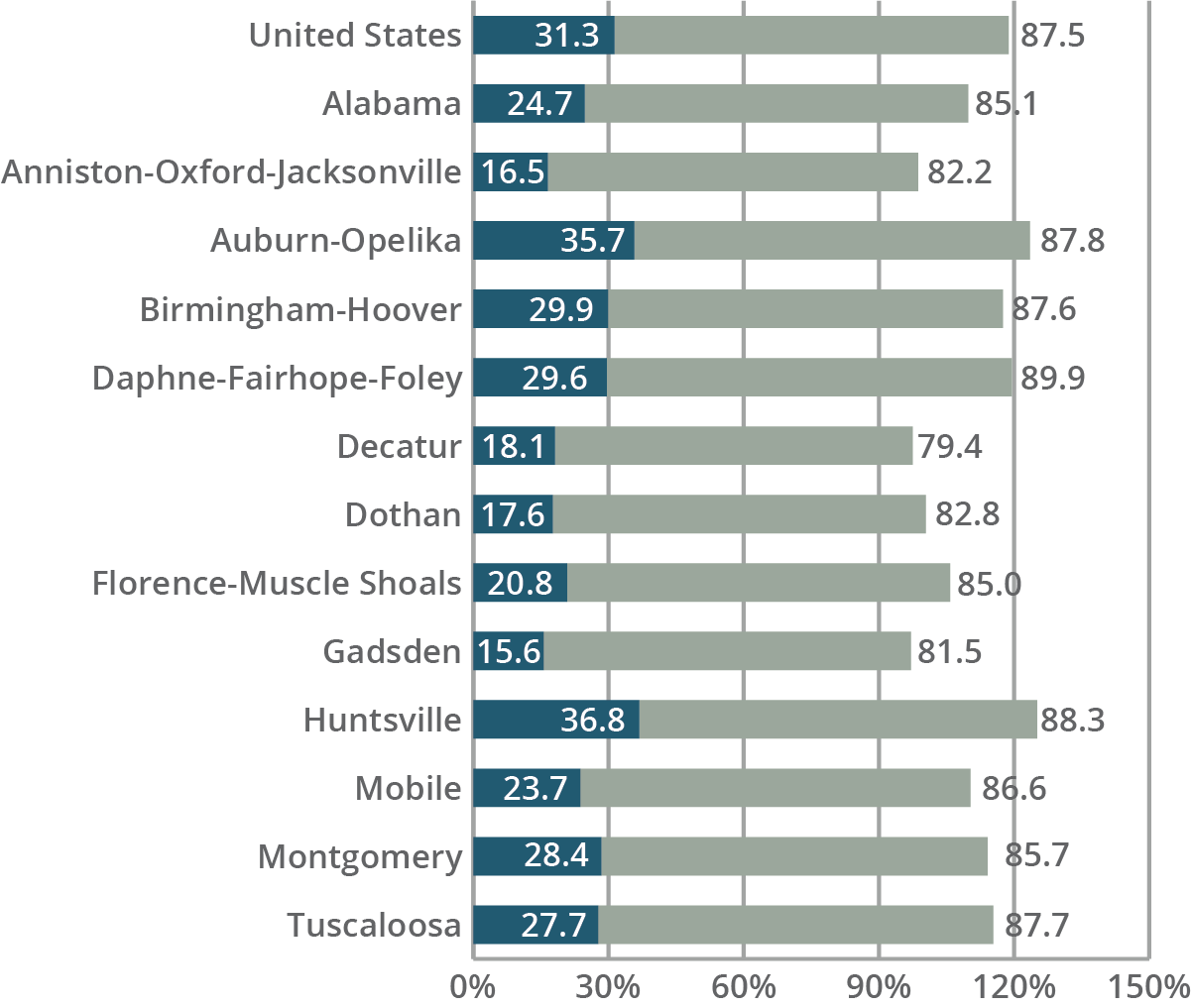
Median Family Income FY2018 & Educational Attainment 2016
Source: U.S. Department of Housing and Urban Development, Office of Economic Affairs, Economic and Market Analysis Division.
Bachelor’s Degree or Higher | High School or Higher, Percent
Note: Percent of population 25 years and over.
Source: U.S. Census Bureau, 2016 American Community Survey 1-year estimates.

Slide 6
Alabama Population: Aging and growing slowly
 | 2000 Census | 2017 Population Estimates | 2000 - 2017
 | (April 1) | (July 1) | Number | Percent
Under 15 years | 931,589 | 903,298 | -28,291 | -3.0%
15 to 64 years | 2,935,713 | 3,167,678 | 231,965 | 7.9%
Under 20 years | 1,256,169 | 1,222,105 | -34,064 | -2.7%
20 to 64 years | 2,611,133 | 2,848,871 | 237,738 | 9.1%
65 years and over | 579,798 | 803,771 | 223,973 | 38.6%
Alabama | 4,447,100 | 4,874,747 | 427,647 | 9.6%
US | 281,421,906 | 325,719,178 | 44,297,272 | 15.7%
 | 2010 Census | 2017 Population Estimates | 2010 - 2017
 | (April 1) | (July 1) | Number | Percent
Alabama | 4,779,736 | 4,874,747 | 427,647 | 1.86%
US | 308,745,538 | 325,719,178 | 44,297,272 | 5.30%
Source: U.S. Census Bureau, Population Division.

Slide 7
Alabama Population Pyramid, 2017
Source: U.S. Census Bureau, Population Division.

Slide 8
Population gains varied widely since 2010
 |  | 7/1/2010 - 7/1/2017
 | 7/1/2017 | Number Change | Percent Change
Alabama | 4,874,747 | 89,168 | 1.9
Anniston-Oxford-Jacksonville | 114,728 | -3,738 | -3.2
Auburn-Opelika | 161,604 | 20,798 | 14.8
Birmingham-Hoover | 1,149,807 | 21,016 | 1.9
Daphne-Fairhope-Foley | 212,628 | 29,518 | 16.1
Decatur | 151,867 | -2,082 | -1.4
Dothan | 147,914 | 2,044 | 1.4
Florence-Muscle Shoals | 147,038 | -222 | -0.2
Gadsden | 102,755 | -1,702 | -1.6
Huntsville | 455,448 | 36,169 | 8.6
Mobile | 413,955 | 635 | 0.2
Montgomery | 373,903 | -1,225 | -0.3
Tuscaloosa | 242,799 | 12,312 | 5.3
Source: U.S. Census Bureau, Population Division.

Slide 9
Population Projections
 |  |  |  |  | 2010 to 2030
 | Census |  |  |  | Number | Percent
 | 2010 | 2020 | 2025 | 2030 | Change | Change
United States | 308,745,538 | 332,639,000 | 344,234,000 | 355,101,000 | 46,355,462 | 15.0
Alabama | 4,779,736 | 4,940,253 | 5,030,870 | 5,124,380 | 344,644 | 7.2
Anniston-Oxford-Jacksonville | 118,572 | 114,221 | 113,195 | 112,529 | -6,043 | -5.1
Auburn-Opelika | 140,247 | 169,234 | 180,742 | 191,587 | 51,340 | 36.6
Birmingham-Hoover | 1,128,047 | 1,167,297 | 1,188,772 | 1,210,100 | 82,053 | 7.3
Daphne-Fairhope-Foley | 182,265 | 222,554 | 242,345 | 261,777 | 79,512 | 43.6
Decatur | 153,829 | 152,125 | 151,987 | 152,258 | -1,571 | -1.0
Dothan | 145,639 | 151,543 | 155,113 | 158,747 | 13,108 | 9.0
Florence-Muscle Shoals | 147,137 | 147,038 | 146,940 | 147,016 | -121 | -0.1
Gadsden | 104,430 | 102,137 | 101,245 | 100,612 | -3,818 | -3.7
Huntsville | 417,593 | 472,222 | 500,403 | 528,141 | 110,548 | 26.5
Mobile | 412,992 | 416,420 | 419,698 | 423,249 | 10,257 | 2.5
Montgomery | 374,536 | 377,195 | 381,633 | 386,277 | 11,741 | 3.1
Tuscaloosa | 230,162 | 248,021 | 256,385 | 264,148 | 33,986 | 14.8
Source: U.S. Census Bureau, Population Division and Center for Business and Economic Research, The University of Alabama, April 2018.

Slide 10

The Economy and Economic Development
Economy = People + Institutions + Property = Private & Public Sectors
Economic Development = Higher or better quality of life
Human Capital Development = Improved education and healthcare
Institutional Development = Better government, companies, culture
Physical Capital Development = Better infrastructure and environment
Workforce development (especially education) is the most essential
part of Economic development
*** Informal education and employment efforts are also important

Slide 11

Growing the Alabama Economy
Sustained and optimal economic growth for Alabama will require rebalancing the economy by raising the public spending share of GDP
Goal: Broad-based economic growth for all of Alabama with a focus on increasing the ratio of state to national per capita income
Education is key (no economic development otherwise)
Healthcare too
A better tax system is needed because what we currently have
  raises inadequate revenue
  is regressive
  is inefficient in both collection and use
Alabama needs MORE REVENUE and both tax and budget reform

Slide 12
Suggestions for a Better Tax System to Support Optimal Economic Growth for Alabama
Acknowledge scale of problem; about $2.0 billion (1% of GDP) is needed
  We have to properly define the problem before we can solve it. From the perspective of “optimality” or asking what is best for Alabama, funds are needed to address expected/projected budget shortfalls as well as to properly address workforce development (education and other programs), infrastructure improvements, and economic development incentives. The economy is a system of interacting public and private sectors; a "healthy" public sector enables the private sector and economy as a whole to grow in the best way possible.
  Removal of federal income tax deduction: $700-850 million
  Lowering sales tax rate and broadening base (+20%): $430 million
  Raising state property tax from 6.5 mills to 13 mills: $370 million
  Instituting road use fees (1-cent per mile): $680 million
  Use $400-500 million for incentives and budget reconciling

Slide 13
Economic Impact of $2 Billion Rebalancing
Net effects indicate that rebalancing is worth it.
$ Millions | Consumption Reduction | Government Spending | Net Effect
Output | ($3,953) | $4,981 | $1,027
GDP | ($1,956) | $2,465 | $508
Earnings | ($1,110) | $1,526 | $416
Employment (jobs) | (19,842) | 29,896 | 10,054

Slide 14
Rationale for Better Tax System Suggestions
Reduce tax expenditures (especially, federal income tax deduction)
  Eliminating or reducing tax deductions (also called tax expenditures) is not the same as raising taxes; it is rather a removal of subsidies. Deductions are essentially subsidies that were instituted at some point and enable those who can take advantage of them to pay lower state taxes than they would otherwise. Removal or elimination of deductions takes taxpayers back to what they would or should have paid originally so getting rid of them is not the same as raising taxes.
  Economic development incentives are investments which must be accompanied by new revenue. Project selection is vital as the investments MUST pay off; these projects HAVE to provide jobs that pay higher than existing average wage. Incentive programs should be evaluated up front and periodically to ensure that they are worthwhile.

Slide 15
Use of Incentives Requires New Revenue
Without new revenue, incentives unbalance the economy by reducing the public spending share of GDP
Original Economy
New
Original public spending share of GDP
New public spending share of GDP

Slide 16
Rationale for Better Tax System Suggestions
Broaden tax base; lower sales tax rate and apply to services too
  This is needed because the state’s economic structure has been changing. The service sector is the larger and faster-growing part of the economy as consumers spend much more on services than on goods. Both goods production and services provision use up public goods and services for which revenues are needed. As such it is important to generate revenues from both goods and services, not just goods; sales tax collections used to be higher than income tax collections but the reverse is true now.
Raise state property tax
  The state’s tax structure is seriously unbalanced and inefficient in both collection and use with the currently small property tax receipts constituting a significant part of the problem.

Slide 17
Rationale for Better Tax System Suggestions
Institute road use fees
  The gas tax is insufficient for road infrastructure needs and is also much less useful for raising revenues to address those needs. Vehicle miles traveled (VMT) is the proper basis for generating such revenue and the tool to use is a road use fee or VMT fee.
  This can be paid annually at tag renewal with varying fees for different vehicle types (e.g., using axle or weight classes). For example, a one-cent per mile fee for cars would generate $100 for 10,000 miles traveled a year; VMT can be determined from reading odometers.
  The gas tax need not be phased out as its significance will fall naturally over time and it will help with getting some revenue from vehicles that are not domiciled in Alabama. To ensure that revenues are adequate for road infrastructure expenditures, the VMT fee can be assessed and adjusted every few years (e.g., by using a road construction cost index).

Slide 18

Questions, comments, suggestions,…
Thank you
Center for Business and Economic Research
Culverhouse College of Business
The University of Alabama
cber.cba.ua.edu | (205) 348-6191

